Slide 1
Digital Marketing Campaign Conversion Prediction
Henil Kotadiya

Slide 2
Agenda
Introduction
Data Collection & Preprocessing
Exploratory Data Analysis (EDA)
Feature Engineering
Model Building
Model Comparison

Slide 3
Introduction
In the competitive world of digital marketing, accurately predicting customer conversions is key to improving campaign performance.
Overview
Objective: Develop a robust machine learning model to predict customer conversions.
Goal: Improve targeting, boost conversion rates, and maximize ROAS.
Benefits
Improved Targeting: Identify high-conversion customers.
Cost Optimization: Efficient resource allocation reduces wasted spend.
Enhanced Campaigns: Leverage insights for better strategies.

Slide 4

Data Collection & Preprocessing
The majority of the columns (9 out of 19) are of the int64 data type. Additionally, 5 columns are of float64 type, and the remaining 5 are of object type.
Read Dataset :
Insights :
Numbers of Entries : The Datasets consists of 8000 entries.
Columns : The dataset consists of 20 columns, each representing various attributes, including Demographic Information, Marketing-specific Variables, Customer Engagement Metrics, Historical Data, and the Target Variable.
Missing Value : The dataset appears to have no missing values, as all 20 columns contain 8000 non-null entries.
Data Types : The majority of the columns (10 out of 20) are of the Int64 data type. Additionally, 5 columns are of float64 type, and the remaining 5 are of object type.

Slide 5
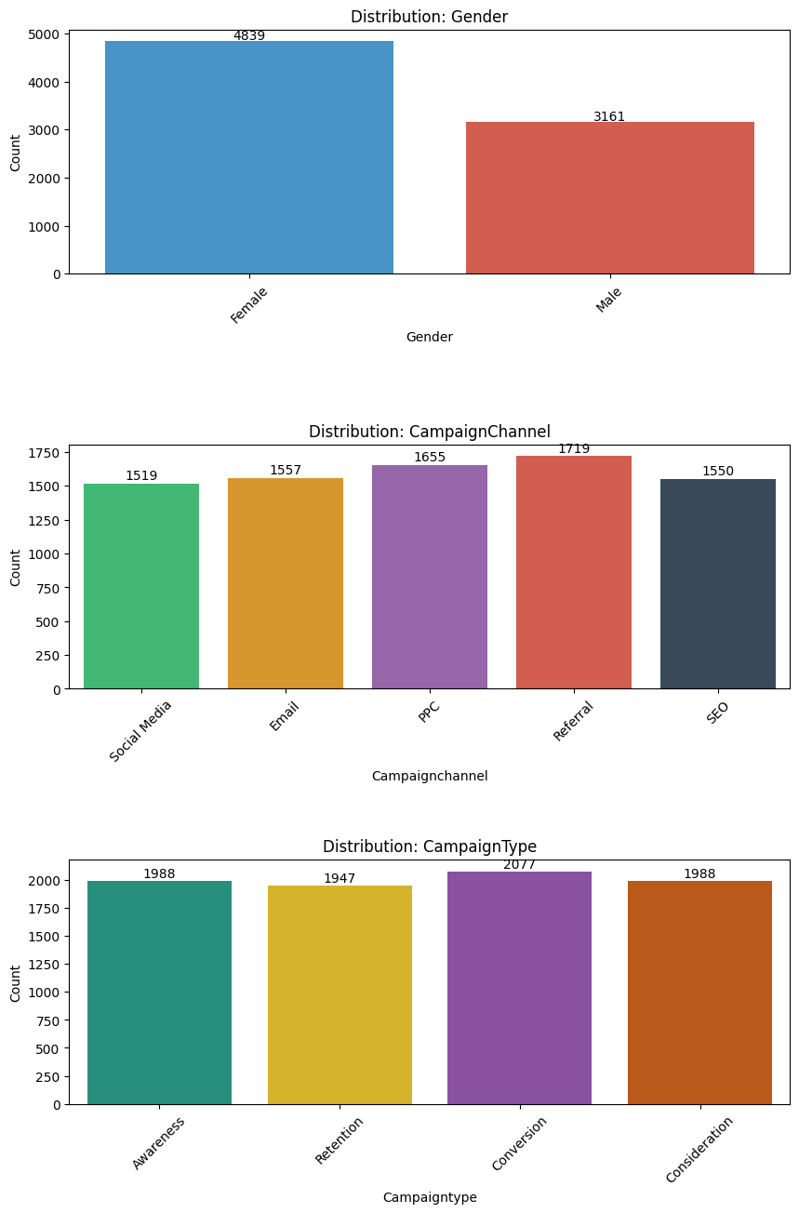
Exploratory Data Analysis (EDA)
Distribution of Categorical Features
Insights :
The dataset has significantly more females (61%) compared to males (39%), indicating that the female demographic may dominate the customer base.
The Referral channel has the highest customer count, suggesting that word-of-mouth or referral-based campaigns are highly effective. Social Media has the lowest engagement, indicating room for improvement in leveraging this channel.
The Conversion campaign type has the highest count, suggesting strong performance in driving customer actions. Retention campaigns have the lowest engagement, highlighting an opportunity to improve strategies for retaining customers.

Slide 6
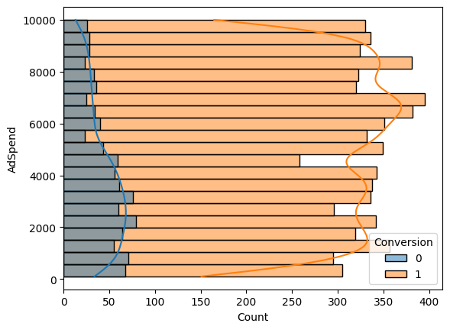
Analyzing Adspend To Conversion Analysis
Insights :
Higher ad spend correlates positively with conversions. Allocating sufficient budget for campaigns likely improves the chances of success.
Campaigns with lower budgets are more likely to fail, potentially due to limited reach or resources.
By focusing on increasing budgets for specific campaigns, conversion rates may improve.

Slide 7
Feature Engineering
Feature Engineering prepares data for machine learning by selecting important features, creating new ones, and ensuring data consistency. It handles missing values and irrelevant information.
Categorical data is converted into numbers using Label Encoding, while numerical features like Age, Income, and Website Visits are standardized to have a mean of 0 and standard deviation of 1, which is important for models like Decision Tree and Random Forest.
The dataset is split into training and testing sets with an 80-20 ratio. The training set is used for model training, and the testing set helps evaluate the model's performance on unseen data.

Slide 8
Model Building
Logistic Regression: A method for predicting one of two possible outcomes by using a curve to fit the data and calculate probabilities.
Decision Tree: A model that makes predictions by splitting data into smaller groups based on simple decision rules.
Random Forest: A group of decision trees working together to make better predictions and avoid mistakes.
SVM (Support Vector Machine): A model that finds the best dividing line to separate different categories, even when the data is complex.
Gradient Boosting: A method that builds small models step by step, each one fixing the errors of the previous one to improve accuracy.
AdaBoost: A technique that combines many small, simple models, focusing on difficult cases, to make stronger predictions.

Slide 9
EVALUATION
Accuracy: Measures the percentage of correct predictions out of all predictions, suitable for balanced datasets.
F1 Score: The harmonic mean of precision and recall, providing a balanced metric for imbalanced imbalanced datasets.
Precision: The ratio of true positives to all positive predictions, indicating how many predicted predicted positives are correct.
Recall: The ratio of true positives to all actual positives, showing how well the model captures positive cases.
ROC AUC Score: Evaluates a model’s ability to distinguish between classes by measuring the area under the ROC curve, where a higher score indicates better performance.

Slide 10
Model Comparison
Metric | Logistic Regression | Decision Tree | Random Forest | Support Vector Machine | Gradient Boosting | AdaBoost
Accuracy | 0.89 | 0.83 | 0.89 | 0.89 | 0.91 | 0.90
F1 Score | 0.89 | 0.83 | 0.89 | 0.89 | 0.91 | 0.90
Precision | 0.68 | 0.62 | 0.83 | 0.86 | 0.87 | 0.88
Recall | 0.99 | 0.63 | 0.57 | 0.57 | 0.68 | 0.62
ROC-AUC Score | 0.57 | 0.63 | 0.57 | 0.57 | 0.68 | 0.62

Slide 11
Conclusion
Best Overall Performance: Gradient Boosting shows the highest accuracy (0.91), F1 Score (0.91), and ROC- AUC Score (0.68), indicating it is the best-performing model in terms of overall classification performance.
Highest Precision: AdaBoost has the highest precision (0.88), which means it has the lowest false positive rate among the models.
Highest Recall: Logistic Regression has the highest recall (0.99), indicating it is the best at identifying positive instances.
Balanced Performance: Gradient Boosting and AdaBoost offer a good balance between precision and recall, making them suitable for applications where both false positives and false negatives need to be minimized.
Lowest Performance: Decision Tree has the lowest performance metrics across the board, with the lowest accuracy (0.83), F1 Score (0.83), precision (0.62), recall (0.63), and ROC-AUC Score (0.63).

Slide 12
Thank You!

